Slide 1
70-533 : Implementing Microsoft Azure Infrastructure Solutions

Slide 2
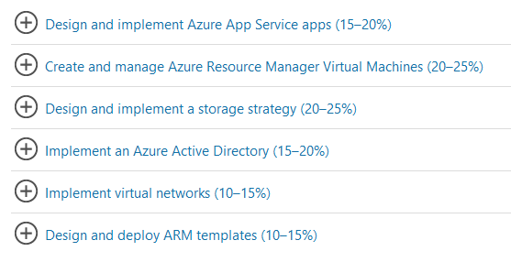
70-533 : Implementing Microsoft Azure Infrastructure Solutions

Slide 3
Implement Blobs, tables and Azure Files and Queue

Slide 4
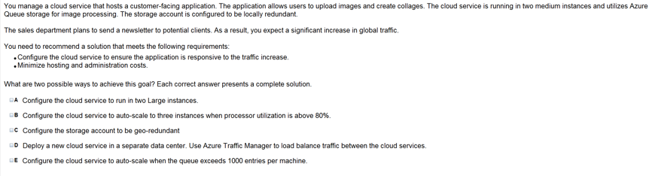
Ans = B & E
Queue here is for asynchronous programing and autoscale is
Best model as you only pay for that moment only

Slide 5
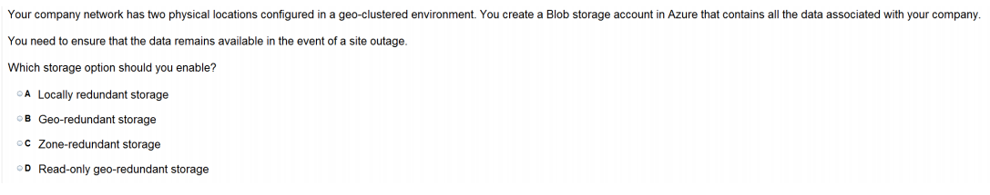
Ans =D

Slide 6
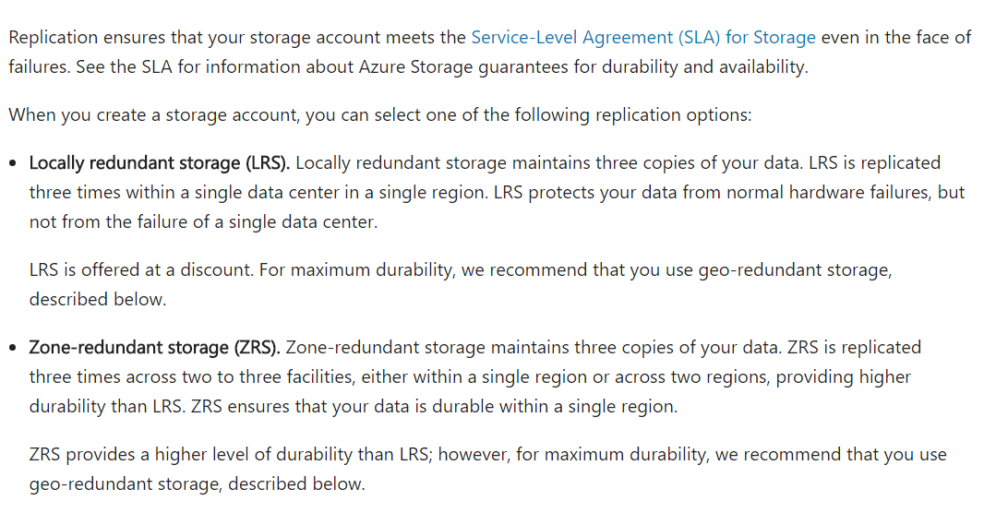

Slide 7
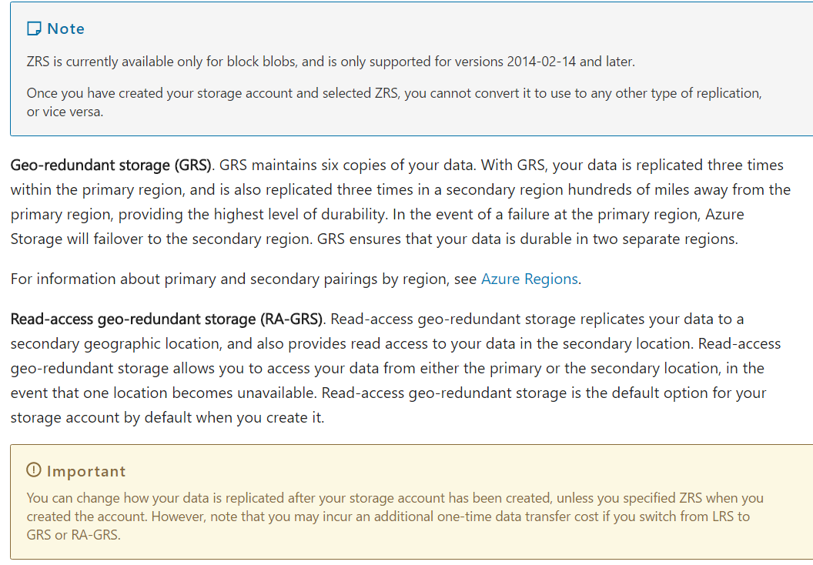

Slide 8
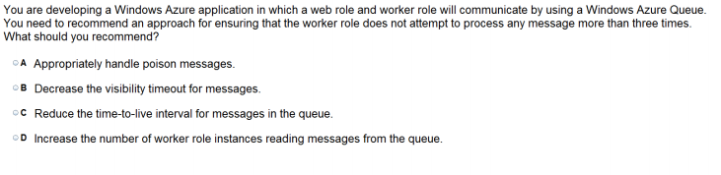
Ans – A How to handle poison messages Messages whose content causes a function to fail are called poison messages. When the function fails, the queue message is not deleted and eventually is picked up again, causing the cycle to be repeated. The SDK can automatically interrupt the cycle after a limited number of iterations, or you can do it manually. Automatic poison message handling The SDK will call a function up to 5 times to process a queue message. If the fifth try fails, the message is moved to a poison queue. The maximum number of retries is configurable. The poison queue is named {originalqueuename}-poison. You can write a function to process messages from the poison queue by logging them or sending a notification that manual attention is needed.

Slide 9
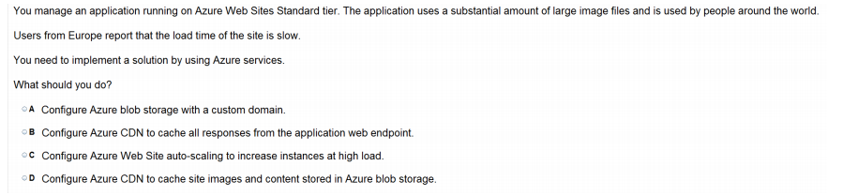
Ans = D
Blobs that benefit the most from Azure CDN caching are those that are accessed frequently
during their time-to-live (TTL) period. A blob stays in the cache for the TTL period and then
is refreshed by the blob service after that time is elapsed. Then the process repeats.

Slide 10
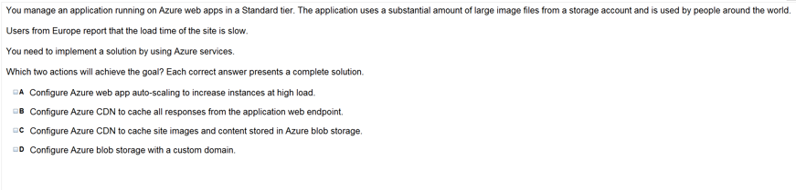
Ans =B & C

Slide 11
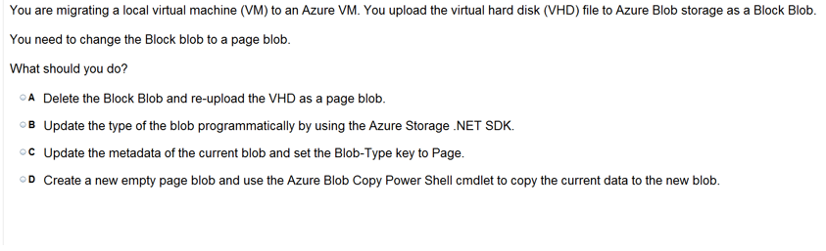
Ans =A

Slide 12
For migrating your local virtual machine (VM) to an Azure VM. You upload (VHD) file to Azure Blob storage as a Block Blob. Now need to change the Block Blob to a page blob. What options ?
A. Delete the Block Blob and re-upload the VHD as a page blob.
B. Update the type of the blob programmatically by using the Azure Storage .NET SDK.
C. Update the metadata of the current blob and set the Blob-Type key to Page.
D. Create a new empty page blob and use the Azure Blob Copy Power Shell cmdlet to copy the current data to the new blob.

Slide 13
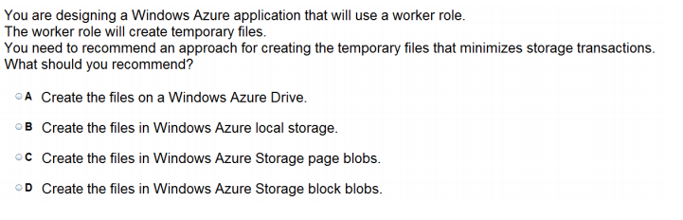
Ans = B
Importantly, local storage is not shared across multiple role instances.
Local Storage is a temporary file system storage area. If you didn’t get from previous sentence, it’s a temporary storage. Local Storage also available to a single role instance and cannot be shared across multiple role instances. What does it mean for you? It means that you should not store any data that you want to be persistent for a long time. If you upgrade a role instance or your instance dies, you will never see the data in the Local Storage again. All important data you should store in Blob, Table Storage or SQL Azure.

Slide 14
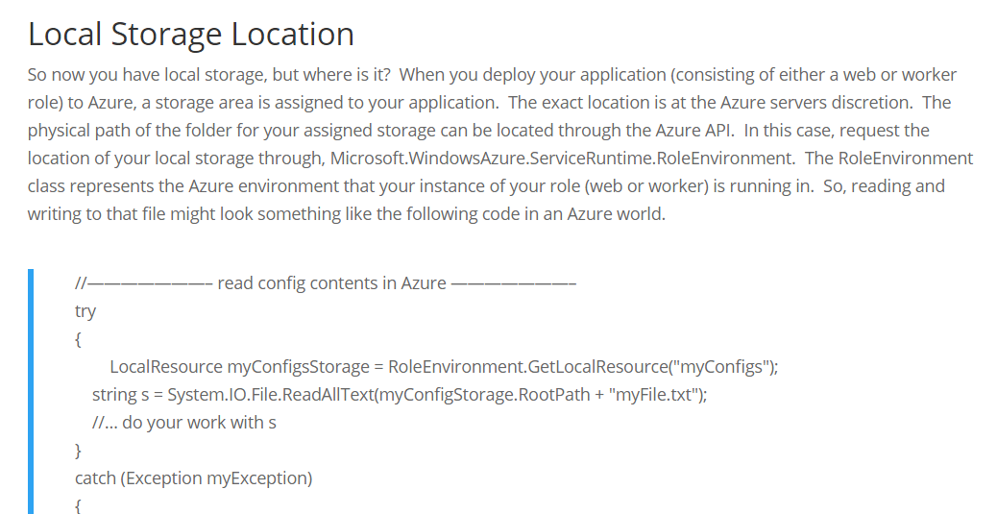

Slide 15
Manage Access

Slide 16
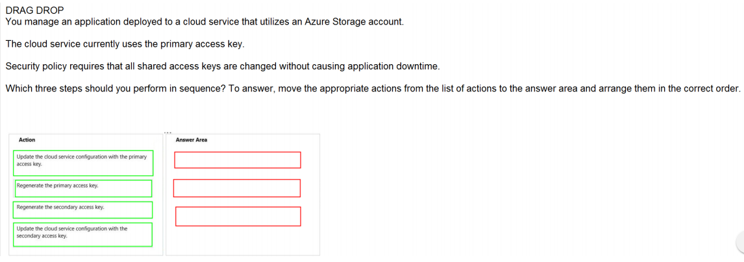
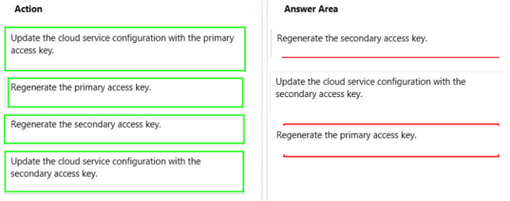
Ans =

Slide 17
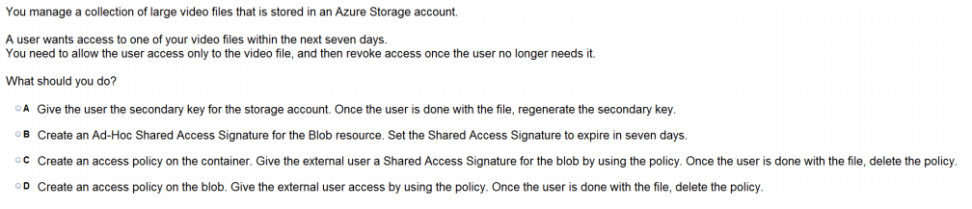
Ans = C
A shared access signature (SAS) is a URI that allows you to specify the time span and permissions allowed for access to a storage resource such as a blob or container. The time span and permissions can be derived from a stored access policy or specified in the URI. We’ll cover both of these in detail later.

Slide 18
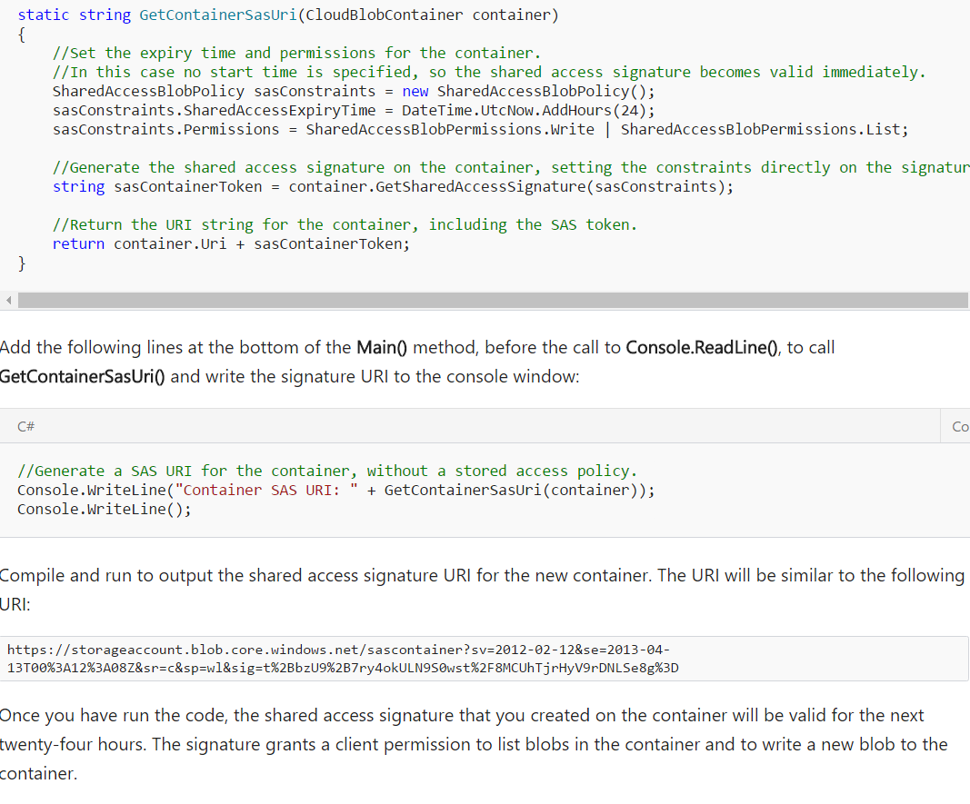

Slide 19
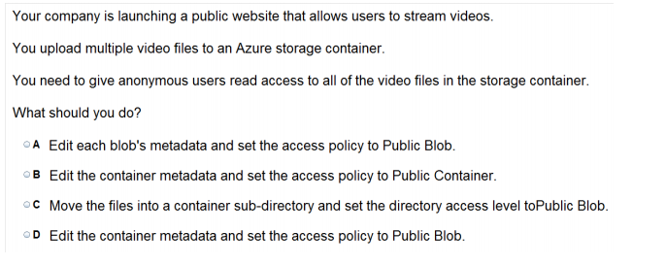
Ans =D

Slide 20
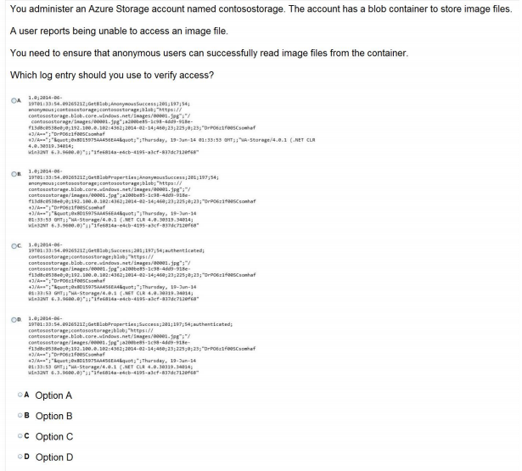
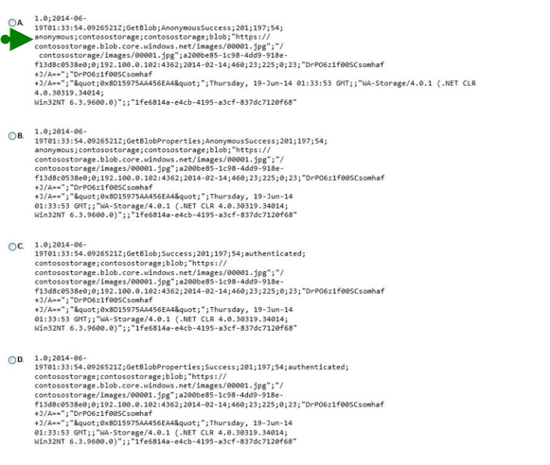

Slide 21
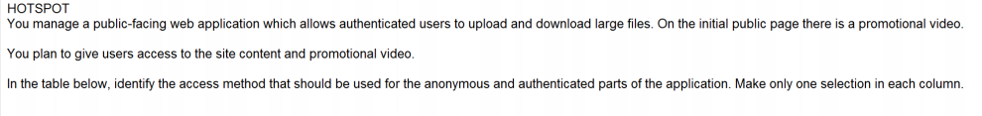
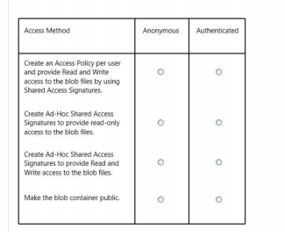
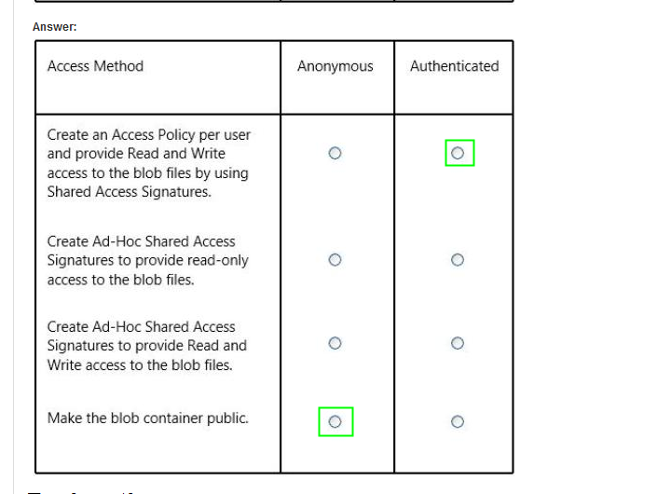
Ans =

Slide 22
Implementing SQL Database and Tables

Slide 23
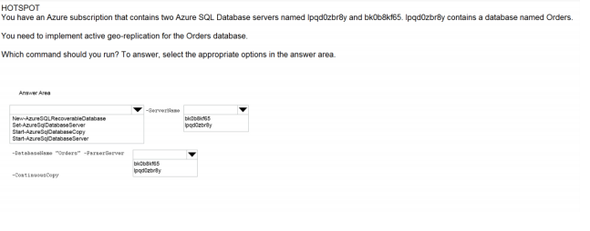
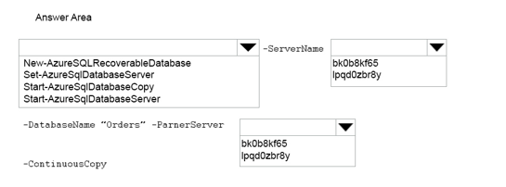
Ans – Start-AzureSqlDatabaseCopy – Source – bk0…. – Destination-ipq…. What to Explain PowerShell

Slide 24
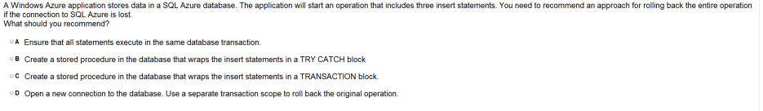
Ans = A
Azure Storage Services officially do not participate in transactions. If a transactional behavior is required, it needs to be implemented in the client system as atomic operations within the limits imposed by Azure Storage Services on atomicity.
The Azure SQL Server supports local transactions (with .NET 4.6.1 and higher), but only grants locks on resources for 20 seconds (when requested by a system task) or 24 hours (otherwise). See Azure SQL Database resource limits for more details.

Slide 25
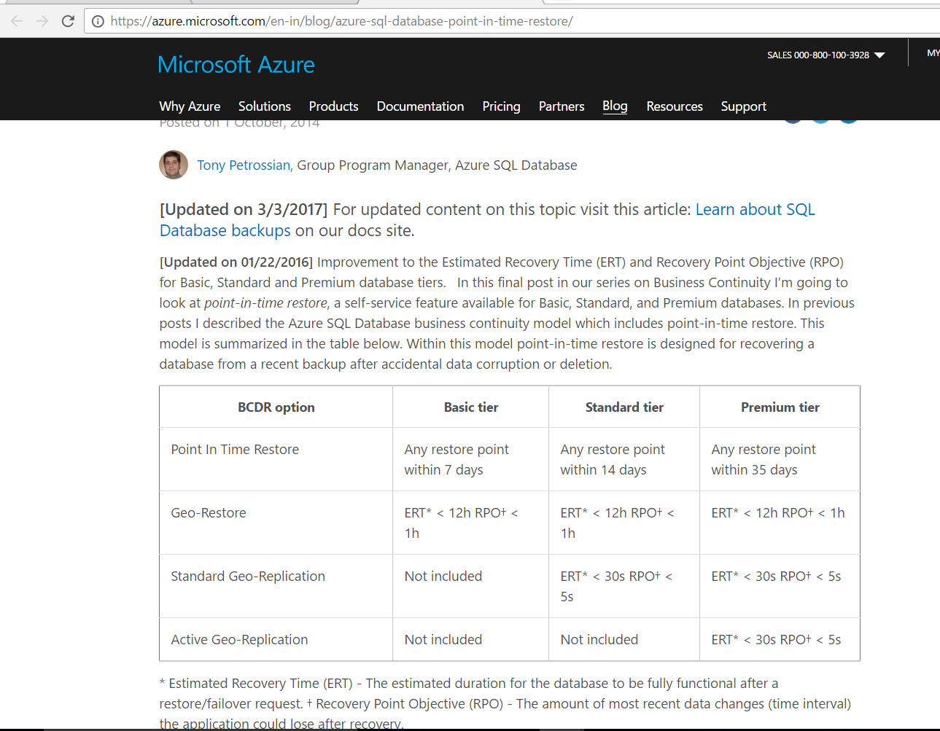

Slide 26
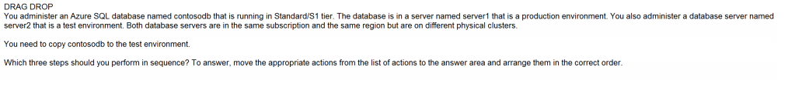
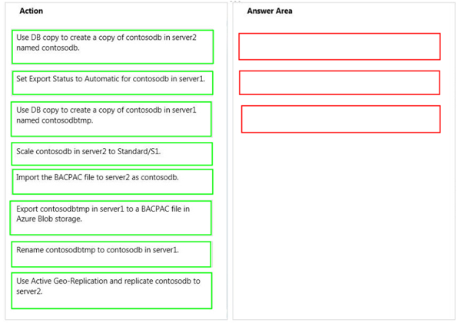
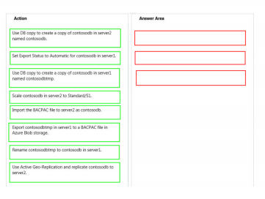
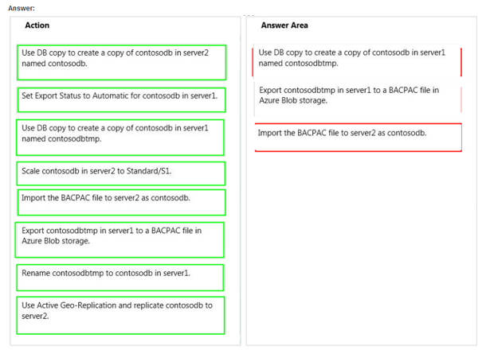
Ans =

Slide 27
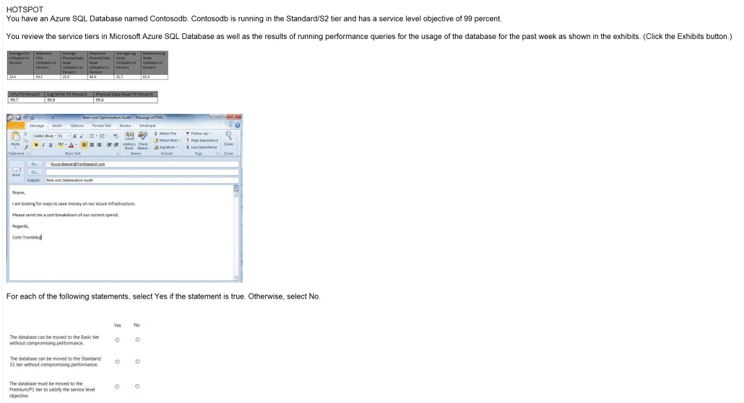
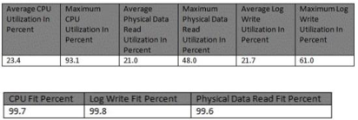
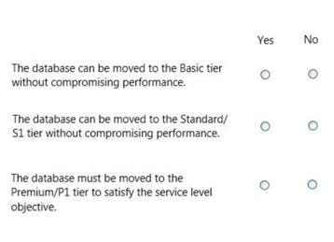
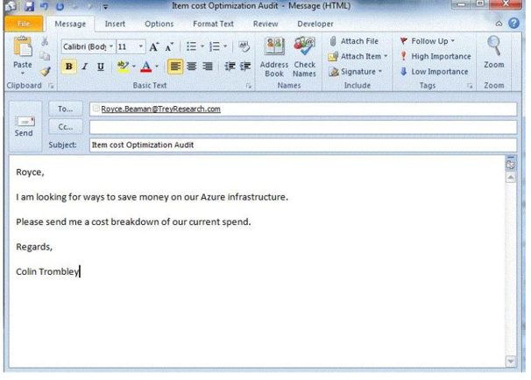
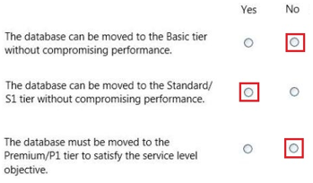

Slide 28
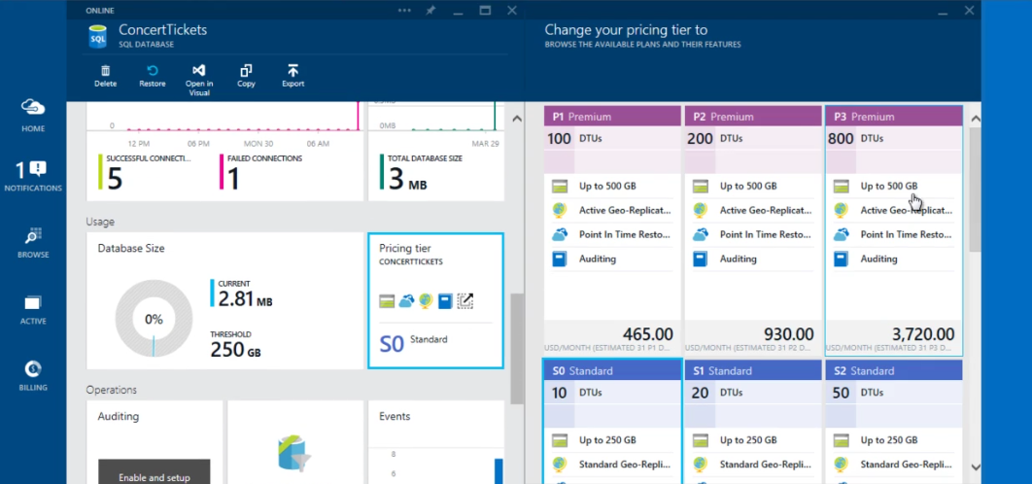
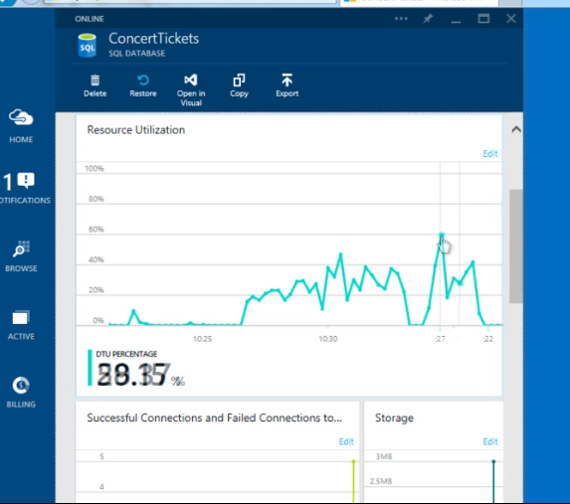
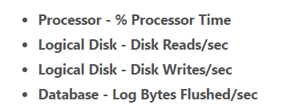
DTU
Resource Utilization Graph
https://docs.microsoft.com/en-us/azure/sql-database/sql-database-service-tiers

Slide 29
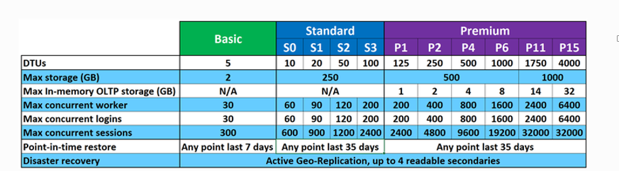
Within the standard and premium tiers, you can see there are different performance levels available. Performance of Azure SQL Database is measured in DTUs. DTUs provide a way to describe the relative capacity of a performance level of Basic, Standard, and Premium databases. DTUs are based on a blended measure of CPU, memory, reads, and writes. As DTUs increase, the power offered by the performance level increases. For example, a standard tier performance level of S0 with 10 DTUs has half the power of a standard tier S1 with 20 DTUs. As you move higher up the performance level ladder you also gain better predictability of performance.
Explanation: * The P1 performance level has 100 DTUs compared to the 200 DTUs of the P2 performance level. That means that the P1 performance level provides half the performance of the P2 performance level. So 50% of CPU utilization in P2 equals 100% CPU utilization inP1. As long as the application does not have timeouts, it may not matter if a big job takes 2 hours or 2.5 hours to complete as long as it gets done today. An application in this category can probably just use a P1 performance level.

Slide 30

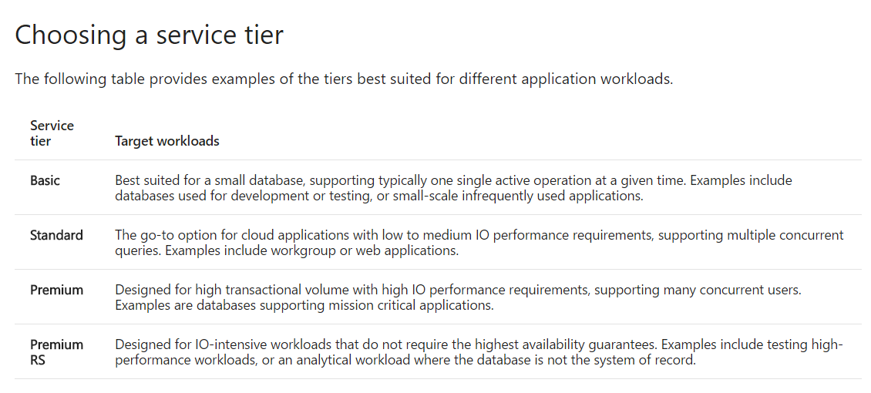

Slide 31
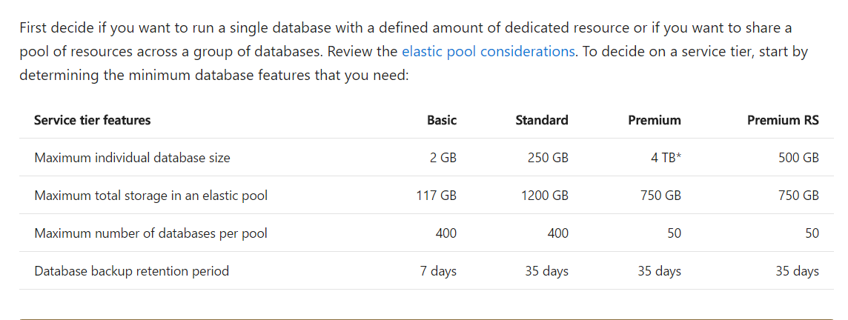

Slide 32
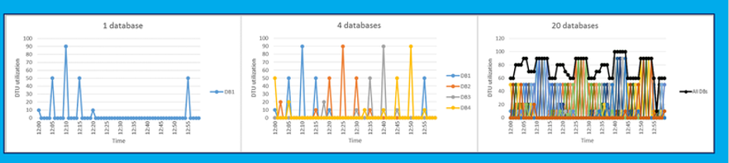
<click> The Rule of thumb: A database is a good candidate for an elastic pool when peak utilization is 1.5x of average utilization

Slide 33
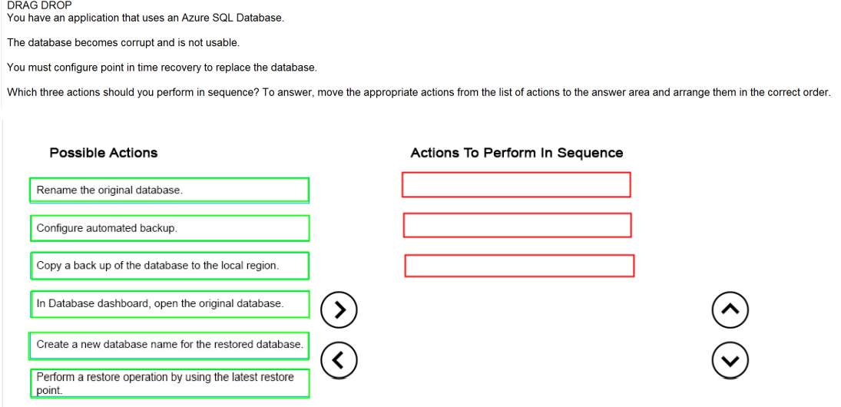
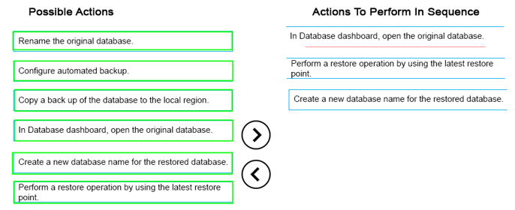
Ans =

Slide 34
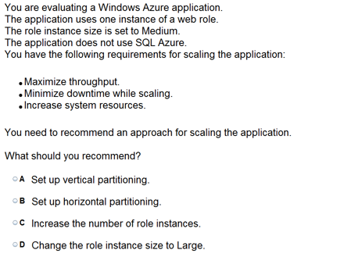
Ans = C
Sacale out

Slide 35
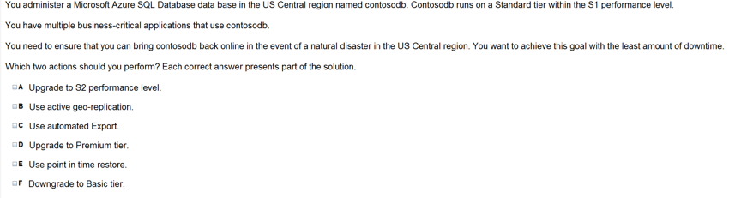
Ans =B & D
Active Geo Replication is with Premium tier only. And
Active Geo-Replication enables you to configure up to four readable secondary
databases in the same or different data center locations (regions). Secondary databases are available
for querying and for failover in the case of a data center outage or the inability to connect to the primary database.
Active geo-replication must be between databases within the same subscription.

Slide 36
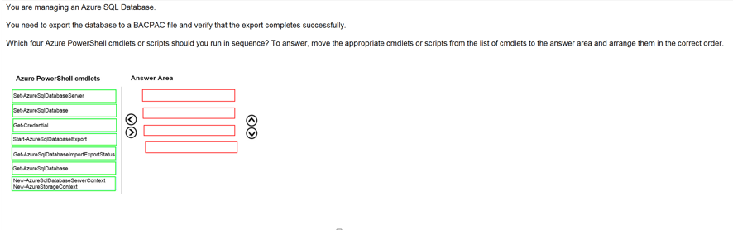
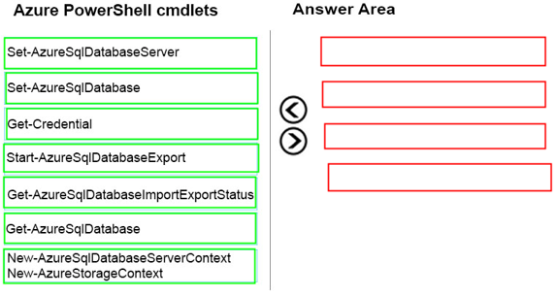
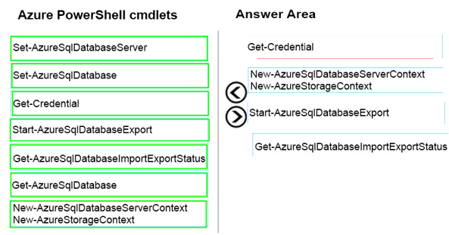
Ans =

Slide 37
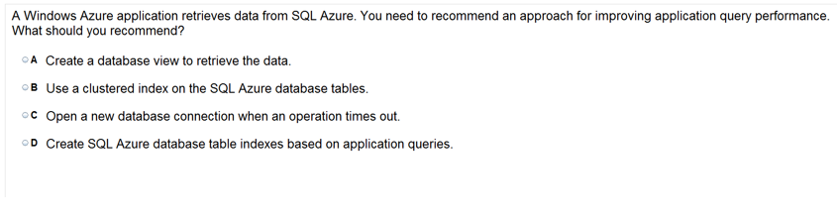
Ans =D
Many Azure SQL Databases fail under load because they lack indexes. They also fail because our queries are far too demanding for the shared nature of the service. Implementing a sound index strategy can help it cope with bad queries. It can also buy you some time so that you can evaluate ways to optimize your Azure SQL Database.
Creating indexes has two really amazing benefits. The first, is that queries will benefit from them without the need to alter existing Stored Procedures. The second, is that you can deploy indexes to your production database without altering code or requiring a full application deployment. Consequently, in most cases, creating indexes to help the overall performance of your Azure solution, will be the lowest hanging fruit. In other words, it will be the cheapest and most effective optimization that you can make.

Slide 38
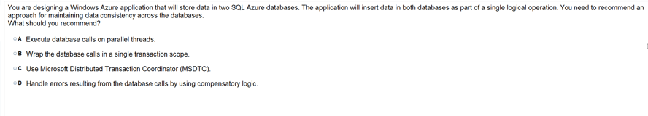
Ans =C The Microsoft Distributed Transaction Coordinator (MSDTC) service is a component of modern versions of Microsoft Windows that is responsible for coordinating transactions that span multiple resource managers, such as databases, message queues, and file systems.
Distributed Transactions
Transactions are supported, but not distributed transactions. From Azure Wiki: “SQL Database does not support distributed transactions, which are transactions that multiple transaction managers (multiple resources)…This means that SQL Database doesn’t allow Microsoft Distributed Transaction Coordinator (MS DTC) to delegate distributed transaction handling. Because of this you can’t use ADO.NET or MSDTC to commit or rollback a single transaction that spans across multiple SQL Databases or a combination of SQL Database and an on-premise SQL Server.”

Slide 39

Whats not in Azure SQL –
http://www.mariner-usa.com/blog/considerations-using-azure-sql-database/

Slide 40

Ans =C

Slide 41



Ans =

Slide 42



Ans =

Slide 43

Ans =C
What is throttling (one CPU)… v/s scalability ( more cpu added)

Slide 44

Ans =A

Slide 45

Ans = D

Slide 46

Ans = D
Http is just for the Read stuff

Slide 47

Ans = A
Using entity group transactions
The Azure Table service supports entity group transactions in which a group of storage operations on entities with the same PartitionKey property are handled automatically. That is, if any operation in the group fails, then all the operations are rolled back. Unlike transactions
in a traditional SQL database, entity group transactions cannot span tables or even partitions.

Slide 48
Configure Diagnostics, Monitoring and Analytics

Slide 49

Ans =C
The Set-AzureStorageServiceLoggingProperty cmdlet modifies logging for Azure Storage services.
C:\PS>Set-AzureStorageServiceLoggingProperty -ServiceType Blob -LoggingOperations Read,Write -PassThru -RetentionDays 10 -Version 1.0

Slide 50

Ans = D
Explanation: All logs are stored in block blobs in a container named $logs, which is automatically created when Storage Analytics is enabled for a storage account. The$logs container is located in the blob namespace of the storage account, for example: http://<accountname>.blob.core.windows.net/$logs. This container cannot be deleted once Storage Analytics has been enabled, though its contents can be deleted.
Note: Each log will be written in the following format: <servicename>/YYYY/MM/DD/hhmm/<counter>.log

Slide 51

Ans =C
which will automatically cleanup ‘old’ logs without you being charged for the cleanup. It is recommended that you set a retention policy for logs such that your analytics data will be within the 20TB limit allowed for analytics data (logs and metrics combined).

Slide 52


